Slide 1
Error Handling and Validation
Chapter 15

Slide 2
Chapter 15
1
2
What Are Errors and Exceptions?
PHP Error Reporting
3
PHP Error and Exception Handling
4
Regular Expressions
5
6
Where to Perform Validation
Validating User Input
7
Summary

Slide 3
Chapter 15
1
2
What Are Errors and Exceptions?
PHP Error Reporting
3
PHP Error and Exception Handling
4
Regular Expressions
5
6
Where to Perform Validation
Validating User Input
7
Summary

Slide 4
What Are Errors and Exceptions?
Types of Errors
Expected errors
Warnings
Fatal errors

Slide 5
What Are Errors and Exceptions?
Types of Errors

Slide 6
What Are Errors and Exceptions?
Exceptions
An exception refers to objects that are of type Exception and which are used in conjunction with the object-oriented try . . . catch language construct for dealing with runtime errors.

Slide 7
Chapter 15
1
2
What Are Errors and Exceptions?
PHP Error Reporting
3
PHP Error and Exception Handling
4
Regular Expressions
5
6
Where to Perform Validation
Validating User Input
7
Summary

Slide 8
PHP Error Reporting
The error_reporting Setting
error_reporting specifies which type of errors are to be reported
ini_set('log_errors','1');
It can also be set within the php.ini file:
log_errors = On

Slide 9
PHP Error Reporting
The display_errors Setting
The display_error setting specifies whether error messages should or should not be displayed in the browser
ini_set('display_errors','0');
It can also be set within the php.ini file:
display_errors = Off

Slide 10
PHP Error Reporting
The log_errors Setting
The log_errors setting specifies whether error messages should or should not be sent to the server error log.
ini_set('log_errors','1');
It can also be set within the php.ini file:
log_errors = On

Slide 11
Chapter 15
1
2
What Are Errors and Exceptions?
PHP Error Reporting
3
PHP Error and Exception Handling
4
Regular Expressions
5
6
Where to Perform Validation
Validating User Input
7
Summary

Slide 12
PHP Error and Exception Handling
Procedural Error Handling
$connection = mysqli_connect(DBHOST, DBUSER, DBPASS, DBNAME);
$error = mysqli_connect_error();
If ($error != null) {
// handle the error
...
}

Slide 13
PHP Error and Exception Handling
Object-Oriented Exception Handling
Exception throwing function (for illustration purposes)
function throwException($message = null,$code = null) {
throw new Exception($message,$code);
}
try {
// PHP code here
$connection = mysqli_connect(DBHOST, DBUSER, DBPASS, DBNAME)
or throwException("error");
...
}
catch (Exception $e) {
echo ' Caught exception: ' . $e->getMessage();
echo ' On Line : ' . $e->getLine();
echo ' Stack Trace: '; print_r($e->getTrace());
} finally {
// PHP code here that will be executed after try or after catch
}

Slide 14
Chapter 15
1
2
What Are Errors and Exceptions?
PHP Error Reporting
3
PHP Error and Exception Handling
4
Regular Expressions
5
6
Where to Perform Validation
Validating User Input
7
Summary

Slide 15
Regular Expressions
A regular expression is a set of special characters that define a pattern.
Regular expressions are a concise way to eliminate the conditional logic that would be necessary to ensure that input data follows a specific format.
PHP, JavaScript, Java, the .NET environment, and most other modern languages support regular expressions (each slightly different)

Slide 16
Regular Expressions
Regular Expression Syntax
A literal is just a character you wish to match in the target
A metacharacter is a special symbol that acts as a command to the regular expression parser
. [ ] \ ( ) ^ $ | * ? { } +
Regular Expression Patterns can be combined to form complex expressions

Slide 17
Regular Expressions
Regular Expression Syntax Patterns
^ qwerty $ If used at the very start and end of the regular expression, it means that the entire string (and not just a substring) must match the rest of the regular expression contained between the ^ and the $ symbols.
\t Matches a tab character.
\n Matches a new-line character.
. Matches any character other than \n.

Slide 18
Regular Expressions
Regular Expression Syntax Patterns
[qwerty] Matches any single character of the set contained within the brackets.
[^qwerty] Matches any single character not contained within the brackets.
[a-z] Matches any single character within range of characters.
\w Matches any word character. Equivalent to [a-zA-Z0-9].
\W Matches any nonword character.

Slide 19
Regular Expressions
Regular Expression Syntax Patterns
\s Matches any white-space character.
\S Matches any nonwhite-space character.
\d Matches any digit.
\D Matches any nondigit.
* Indicates zero or more matches.
+ Indicates one or more matches.
? Indicates zero or one match.

Slide 20
Regular Expressions
Regular Expression Syntax Patterns
{n} Indicates exactly n matches.
{n,} Indicates n or more matches.
{n, m} Indicates at least n but no more than m matches.
| Matches any one of the terms separated by the | character. Equivalent to Boolean OR.
() Groups a subexpression. Grouping can make a regular expression easier to understand.

Slide 21
Regular Expressions
Extended Example
^(\(?\s*\d{3}\s*[\)–\.]?\s*)?[2-9]\d{2}\s*[–\.]\s*\d{4}$

Slide 22
Chapter 15
1
2
What Are Errors and Exceptions?
PHP Error Reporting
3
PHP Error and Exception Handling
4
Regular Expressions
5
6
Where to Perform Validation
Validating User Input
7
Summary

Slide 23
Validating User Input
Types of Input Validation
Required information
Correct data type
Correct format
Comparison
Range Check
Custom

Slide 24
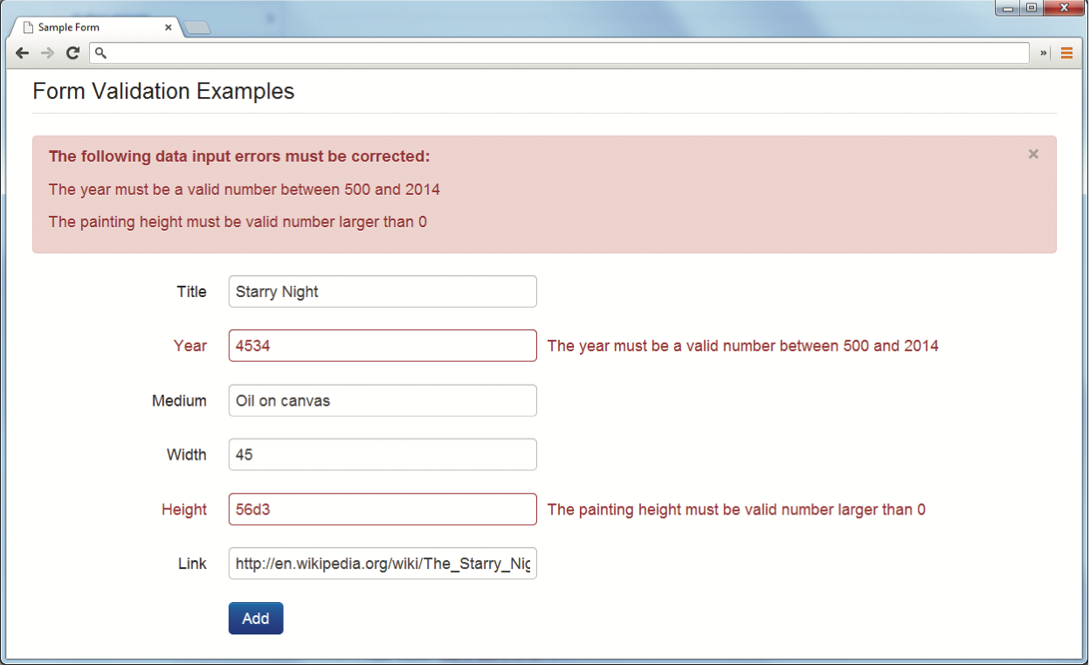
Validating User Input
Notifying the User

Slide 25
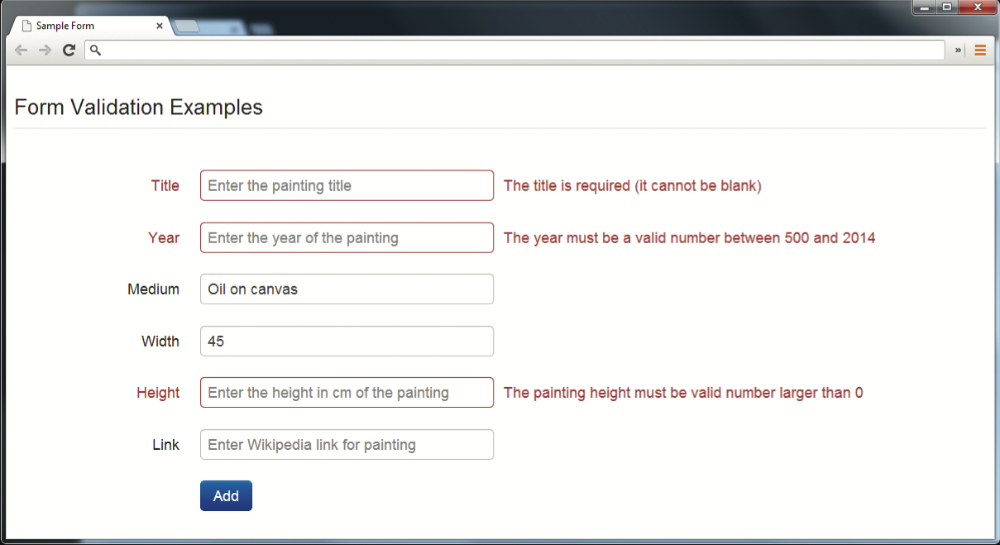
Validating User Input
How to Reduce Validation Errors – show where error located

Slide 26
Validating User Input
How to Reduce Validation Errors – providing textual hints

Slide 27
Validating User Input
How to Reduce Validation Errors – use tool tips

Slide 28
Validating User Input
How to Reduce Validation Errors – use input masks

Slide 29
Chapter 15
1
2
What Are Errors and Exceptions?
PHP Error Reporting
3
PHP Error and Exception Handling
4
Regular Expressions
5
6
Where to Perform Validation
Validating User Input
7
Summary

Slide 30
Where to Perform Validation

Slide 31
Where to Perform Validation
Validation at the JavaScript Level
Client process
Can reduce server load
Can be bypassed

Slide 32
Where to Perform Validation
Validation at the PHP Level
Validation on the server side using PHP is the most important form of validation and the only one that is absolutely essential.

Slide 33
Chapter 15
1
2
What Are Errors and Exceptions?
PHP Error Reporting
3
PHP Error and Exception Handling
4
Regular Expressions
5
6
Where to Perform Validation
Validating User Input
7
Summary

Slide 34
Summary
Key Terms
CAPTCHA
error
exception
expected error
fatal errors
literal
metacharacter
regular expression
spam bots
warnings

Slide 35
Summary
Questions?

